Slide 1
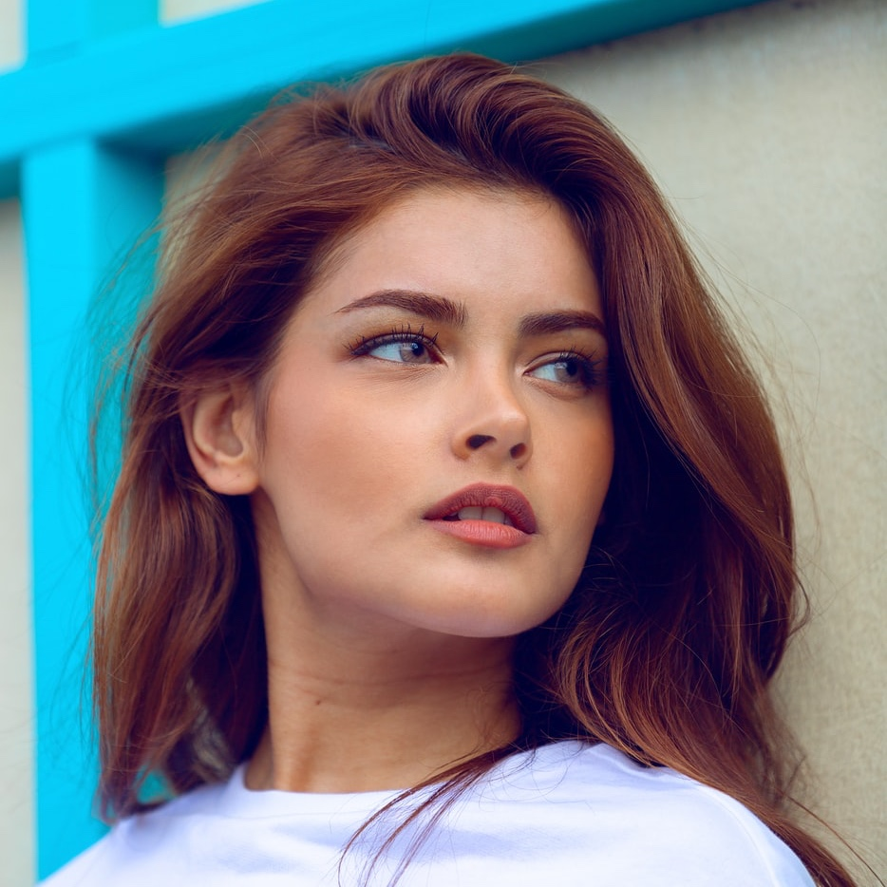
Jeanine Rios
Graphic Designer
“I have a dream to gain the freedom to help people Through new products, helping then grow through experiences and achieving their dreams and their freedom.”
Contact
+1 (234) 567-8900
www.domain-here.com
@domain
1234 SW 40 St, City, Country 12345
username@domain.com
@domain
Education
Bachelor / Degree
University of Chicago
2003 – 2007
Bachelor / Degree
University of Chicago
2009 – 2011
Bachelor / Degree
University of Chicago
2012 – 2014
Experience
Job Title. Company, Location, 2007 – 2009
Developed and maintained print/web collateral, graphical standards, marketing. Coordinated, designed and maintained both WordPress and CSS/HTML websites. Worked in conjunction with the Director of Communications, as well as the Director of Development and led the creative team in creating integrated marketing.
Job Title. Company, Location, 2009 – 2011
Manage corporate marketing for key products and events, managing Direct Marketing, Events and Sponsorships to ensure profitability. Develop and manage key relationships with agencies, vendors and suppliers, providing marketing solutions to ensure market share growth.
Job Title. Company, Location, 2011 – 2012
Manage corporate marketing for key products and events, managing Direct Marketing, Events and Sponsorships to ensure profitability. Develop and manage key relationships with agencies, vendors and suppliers, providing marketing solutions to ensure market share growth.

Slide 2
Job Title. Company, Location, 2002 – 2014
Actively researched industry trends to bring new ideas and applications to company. Maintained project management schedules, databases, and forecast. Formed relationships with magazine and printing salespersons. Collaborated with marketing personnel in development of product information
Job Title. Company, Location, 2014 – 2017
Worked in a lead role to provide supervision and guidance to junior designers. Utilize large format printing for billboards and trade shows and digital photography to enhance proposed work. Planned and executed the presentation of arrangements in graphic form or in detailed scale models. Collected, analyzed, interpreted.
Job Title. Company, Location, 2017 – present
Provided proposal layouts and designs under extremely tight deadlines. Established trusting relationships with outside venders, designers and key clients. Recognized for fresh and innovative ideas and applications. Assisted in marketing strategies and research. Designed and produced trade show booths, company presentations, product labels.
References
Mary Alexander
Company
+1 (234) 567-8900
maryalexander@domain.com
Scott Hernández
Company
+1 (234) 567-8900
scotthpd@domain.com
Donald Wright
Company
+1 (234) 567-8900
donald.wright@domain.com
Skills
Adobe Creative Cloud
Microsoft Word
Microsoft PowerPoint
HTML / CSS
Canva
Sketch
Interests
Gaming
Music
Reading
Coffee
Traveling
Awards
Name of Award
Company, 2006 – 2007
Name of Award
Company, 2012 – 2013
Name of Award
Company, 2015 – 2016

